Slide 1
Teck Ghee Heartlands A38

Slide 2
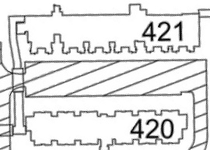
Block A38 CAR PARK SPACE PLAN

Slide 3
421
A38
420

Slide 4
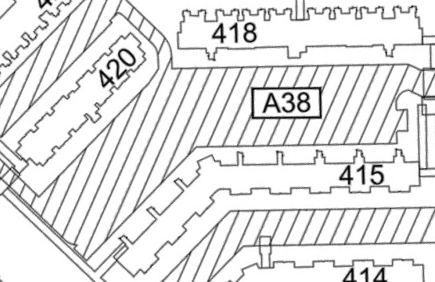
Block A38 CAR PARK SPACE PLAN

Slide 5
418
420
A38
415

Slide 6
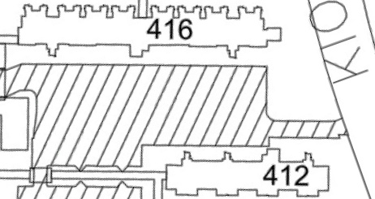
Block A38 CAR PARK SPACE PLAN

Slide 7
416
Ang Mo Kio Ave 10
A38
412

Slide 8
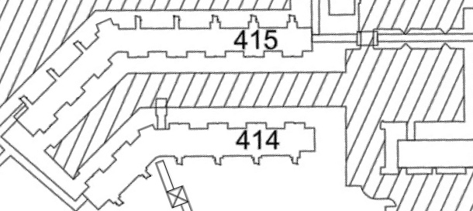
Block A38 CAR PARK SPACE PLAN

Slide 9
415
A38
414

